Slide 1


The Principle Of Relatedness Pierre-Alexandre Balland
Notes:
Also talk about paper with dave + assignment

Slide 2
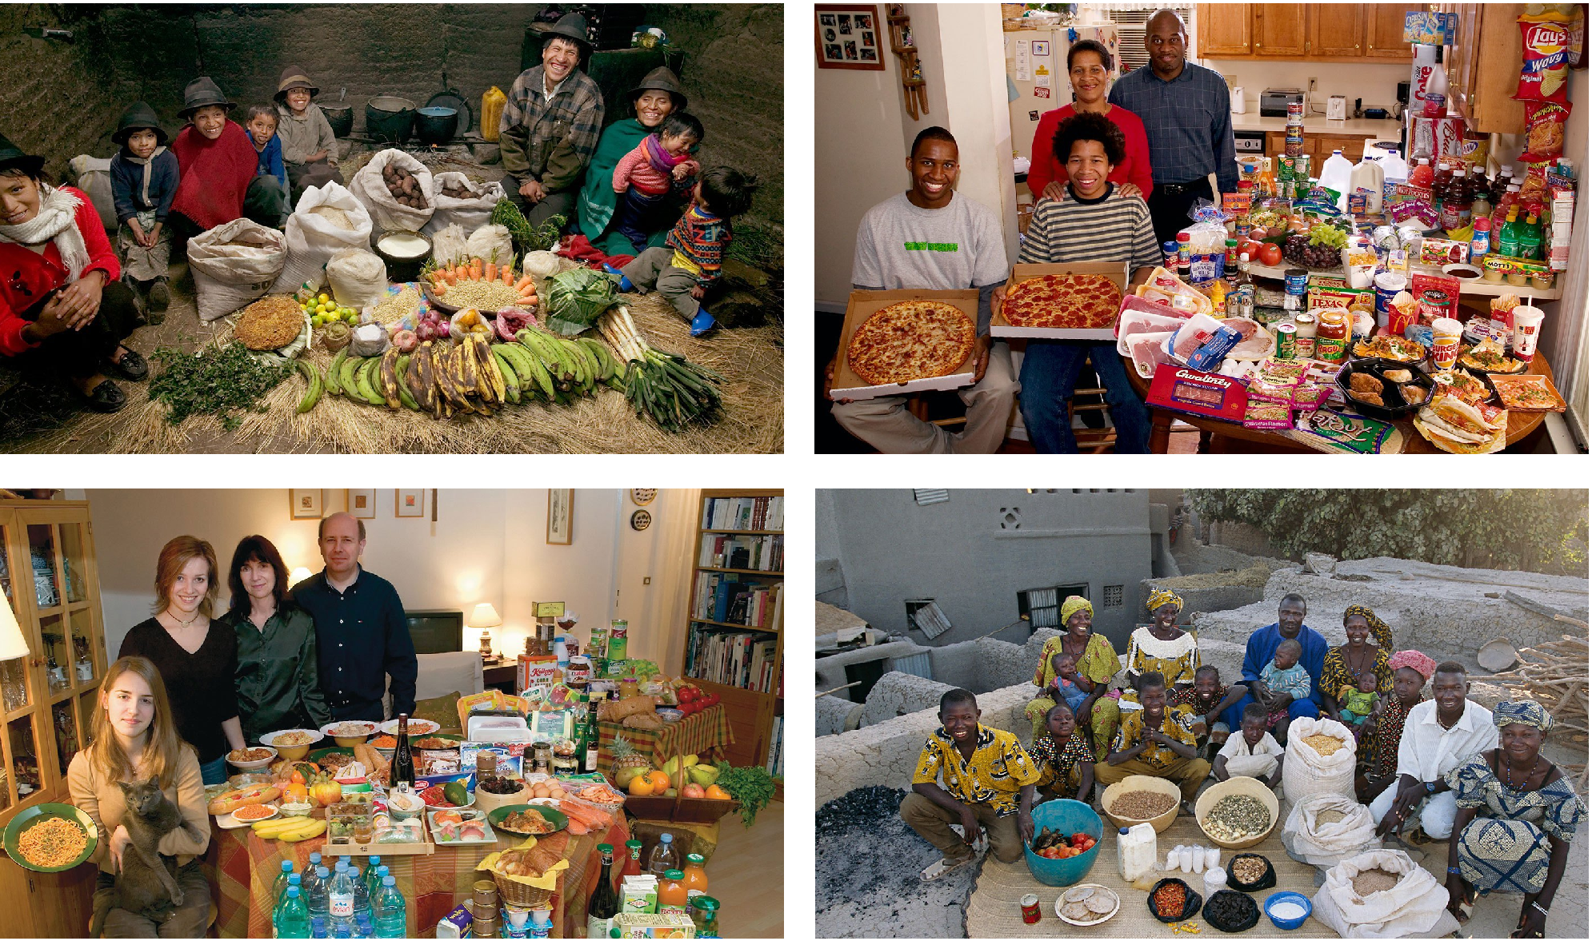
Reframing economic development
Ecuador - $8.17/day | 3.82% < Pov. (PovcalNet)
USA – $48.19/day | 1.00% < Pov. (PovcalNet)
France– $43.17/day | : 0.08% < Pov. (PovcalNet)
Mali – $1.92/day | 49.25% < Pov. (PovcalNet)
Data Source: PovcalNet - World Bank
Menzel, P. and D’Aluisio F. (2005) Hungry Planet: What the World Eats
Notes:
Data is from the PovcalNet database from the World Bank
International poverty line by the world bank: 1.9 $ PPP (Purchasing Power Parity)
<pov: % of population living in households with consumption or income per person below the poverty line ($1.9/day)
"Median$" is the median of daily per capita income/consumption expenditure from the survey in 2011 PPP.
Given monthly in Povcalnet but I multiplied by 12 and divided by 365 to get it daily
> 248.505*12/365
[1] 8.170027
> 1313.09*12/365
[1] 43.17008
> 58.5022*12/365
[1] 1.92336
> 1465.7*12/365
[1] 48.1874

Slide 3
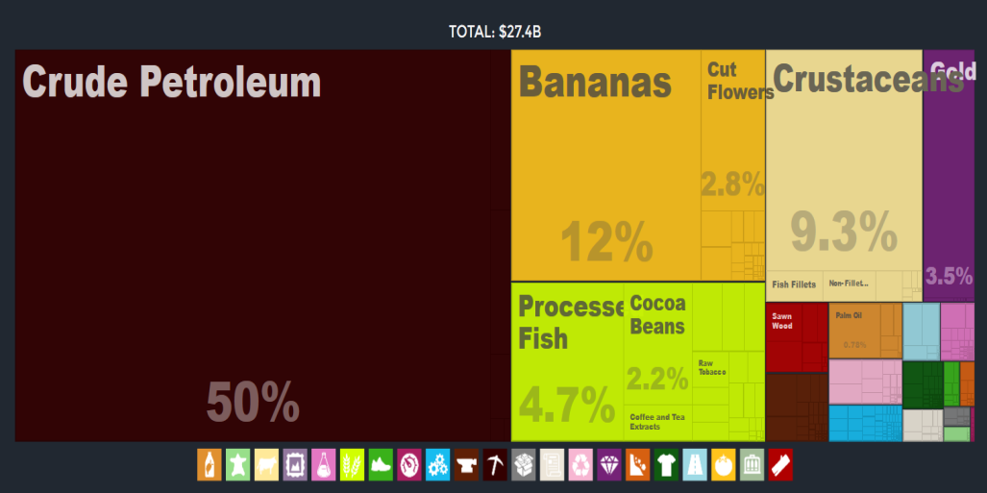
Reframing economic development
USA – $48.19/day | 1.00% < Pov. (PovcalNet)
France– $43.17/day | : 0.08% < Pov. (PovcalNet)
Mali – $1.92/day | 49.25% < Pov. (PovcalNet)
Data Source: atlas.media.mit.edu
Menzel, P. and D’Aluisio F. (2005) Hungry Planet: What the World Eats
Notes:
Data is from the PovcalNet database from the World Bank
International poverty line by the world bank: 1.9 $ PPP (Purchasing Power Parity)
<pov: % of population living in households with consumption or income per person below the poverty line ($1.9/day)
"Median$" is the median of daily per capita income/consumption expenditure from the survey in 2011 PPP.
Given monthly in Povcalnet but I multiplied by 12 and divided by 365 to get it daily
> 248.505*12/365
[1] 8.170027
> 1313.09*12/365
[1] 43.17008
> 58.5022*12/365
[1] 1.92336
> 1465.7*12/365
[1] 48.1874

Slide 4
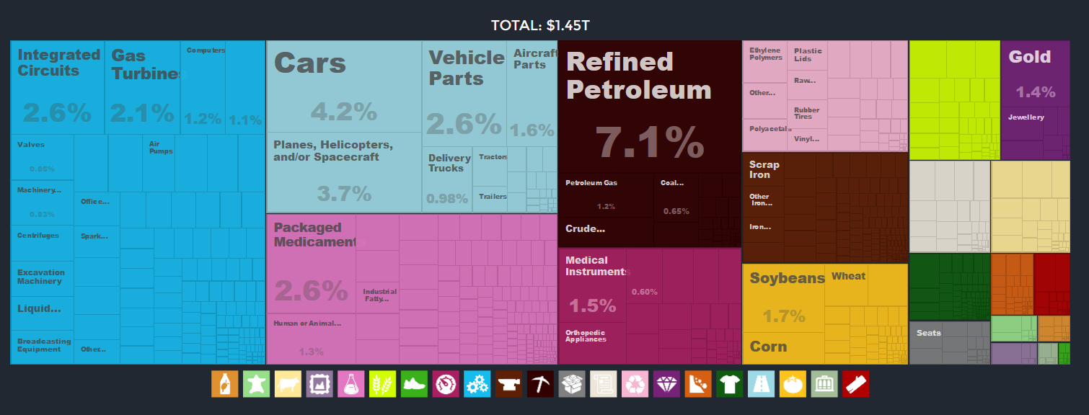
Reframing economic development
USA – $48.19/day | 1.00% < Pov.
France– $43.17/day | : 0.08% < Pov. (PovcalNet)
Mali – $1.92/day | 49.25% < Pov. (PovcalNet)
Data Source: atlas.media.mit.edu
Menzel, P. and D’Aluisio F. (2005) Hungry Planet: What the World Eats
Notes:
Data is from the PovcalNet database from the World Bank
International poverty line by the world bank: 1.9 $ PPP (Purchasing Power Parity)
<pov: % of population living in households with consumption or income per person below the poverty line ($1.9/day)
"Median$" is the median of daily per capita income/consumption expenditure from the survey in 2011 PPP.
Given monthly in Povcalnet but I multiplied by 12 and divided by 365 to get it daily
> 248.505*12/365
[1] 8.170027
> 1313.09*12/365
[1] 43.17008
> 58.5022*12/365
[1] 1.92336
> 1465.7*12/365
[1] 48.1874

Slide 5
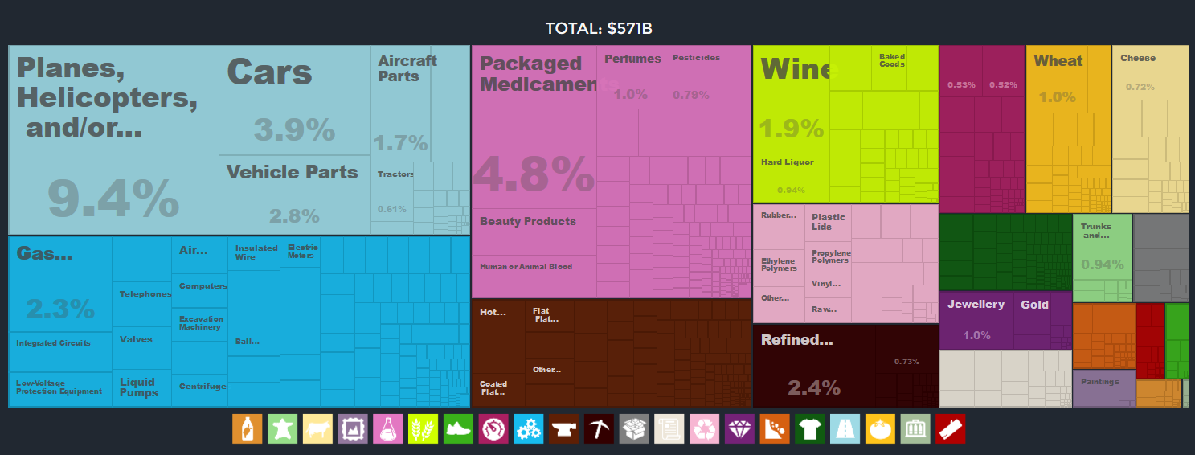
Reframing economic development
USA – $48.19/day | 1.00% < Pov.
France– $43.17/day | : 0.08% < Pov.
Mali – $1.92/day | 49.25% < Pov. (PovcalNet)
Data Source: atlas.media.mit.edu
Menzel, P. and D’Aluisio F. (2005) Hungry Planet: What the World Eats
Notes:
Data is from the PovcalNet database from the World Bank
International poverty line by the world bank: 1.9 $ PPP (Purchasing Power Parity)
<pov: % of population living in households with consumption or income per person below the poverty line ($1.9/day)
"Median$" is the median of daily per capita income/consumption expenditure from the survey in 2011 PPP.
Given monthly in Povcalnet but I multiplied by 12 and divided by 365 to get it daily
> 248.505*12/365
[1] 8.170027
> 1313.09*12/365
[1] 43.17008
> 58.5022*12/365
[1] 1.92336
> 1465.7*12/365
[1] 48.1874

Slide 6
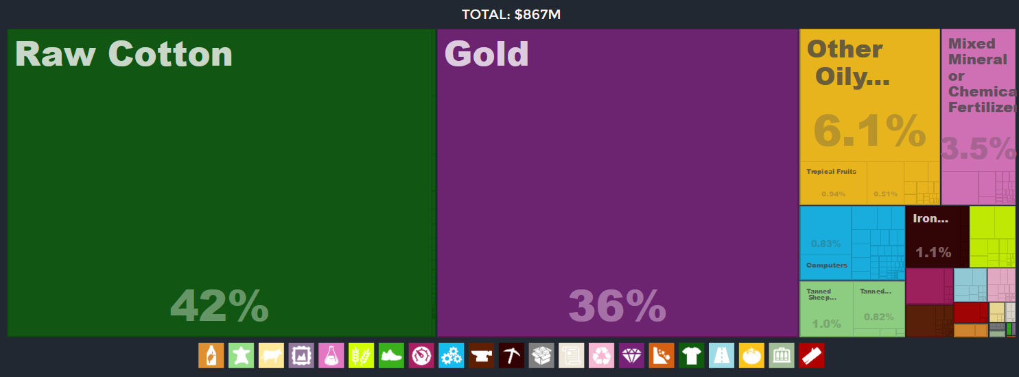
Reframing economic development
USA – $48.19/day | 1.00% < Pov.
France– $43.17/day | : 0.08% < Pov.
Mali – $1.92/day | 49.25% < Pov.
Data Source: atlas.media.mit.edu
Menzel, P. and D’Aluisio F. (2005) Hungry Planet: What the World Eats
Notes:
Path to properity, really about understanding how to move from there to there
Data is from the PovcalNet database from the World Bank
International poverty line by the world bank: 1.9 $ PPP (Purchasing Power Parity)
<pov: % of population living in households with consumption or income per person below the poverty line ($1.9/day)
"Median$" is the median of daily per capita income/consumption expenditure from the survey in 2011 PPP.
Given monthly in Povcalnet but I multiplied by 12 and divided by 365 to get it daily
> 248.505*12/365
[1] 8.170027
> 1313.09*12/365
[1] 43.17008
> 58.5022*12/365
[1] 1.92336
> 1465.7*12/365
[1] 48.1874

Slide 7
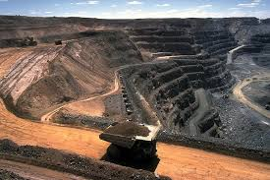



Reframing economic development
USA – $48.19/day | 1.00% < Pov.
France– $43.17/day | : 0.08% < Pov.
Mali – $1.92/day | 49.25% < Pov.
Data Source: atlas.media.mit.edu
Menzel, P. and D’Aluisio F. (2005) Hungry Planet: What the World Eats
Notes:
Path to properity, really about understanding how to move from there to there
Data is from the PovcalNet database from the World Bank
International poverty line by the world bank: 1.9 $ PPP (Purchasing Power Parity)
<pov: % of population living in households with consumption or income per person below the poverty line ($1.9/day)
"Median$" is the median of daily per capita income/consumption expenditure from the survey in 2011 PPP.
Given monthly in Povcalnet but I multiplied by 12 and divided by 365 to get it daily
> 248.505*12/365
[1] 8.170027
> 1313.09*12/365
[1] 43.17008
> 58.5022*12/365
[1] 1.92336
> 1465.7*12/365
[1] 48.1874

Slide 8
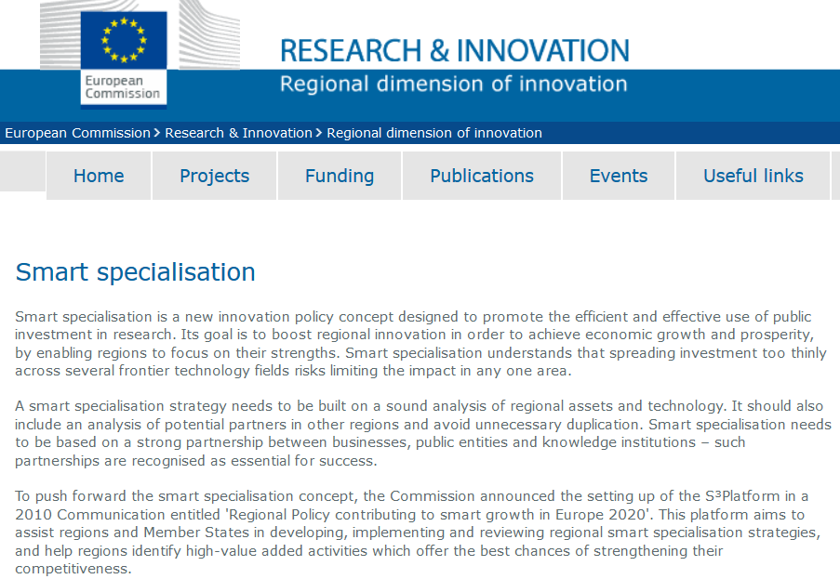
On smart specialization

Slide 9
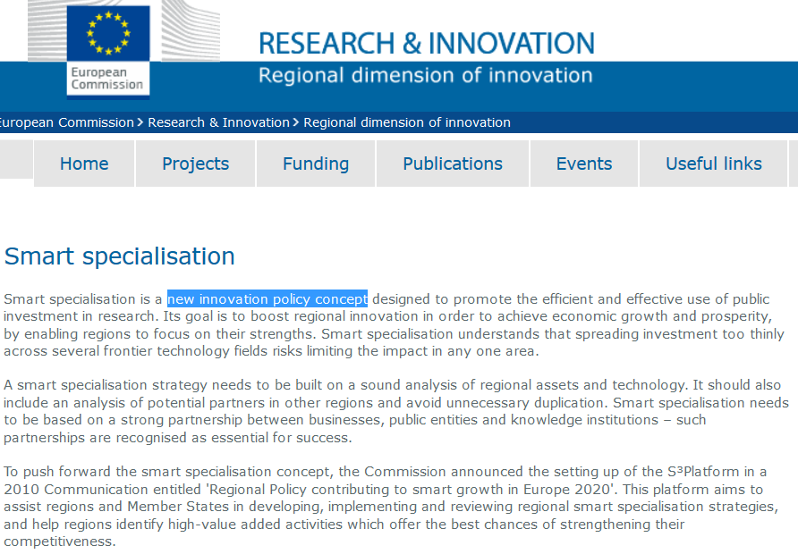
Running ahead of theory?
Notes:
So it is a new innovation policy concept – which has been criticized for running ahead of theory – and this is a problem because regions have to implement a SSS if they want to get money from the EU, and we are talking about € 110 billion for the next 7 years – so more or less 1/3 of the cohesion policy fund. So a challenge is to operationalize these ideas – and we think that the relatedness/complexity framework can help in that respect.
Also exciting times because the commission is divided in different departments – Directorates general – depending on the policy topic it deals with - Regional and urban Policy (REGIO) Research and Innovation (RTD)

Slide 10
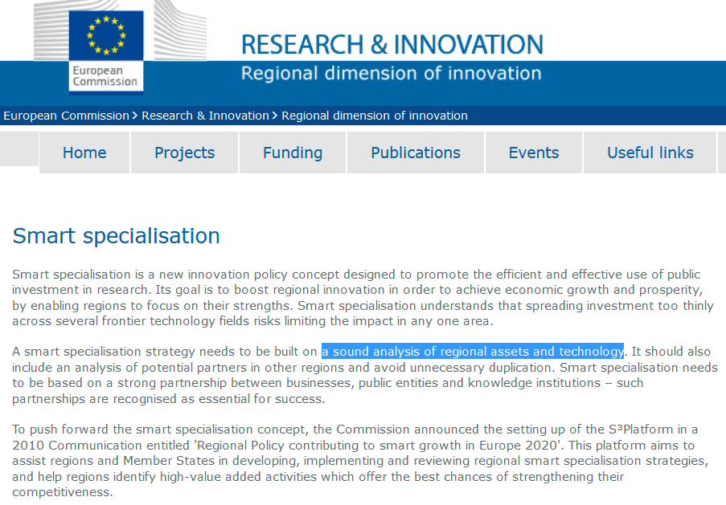
Mapping knowledge bases of regions
Notes:
- That’s a first important element of the SS framework : to provide such an analysis – the work on relatedness can be important – because it is difficult for regions to evaluate what they are doing – how good they are – and you always have regional policy makers coming up with ideas to become the next silicon valley – you do not want that

Slide 11
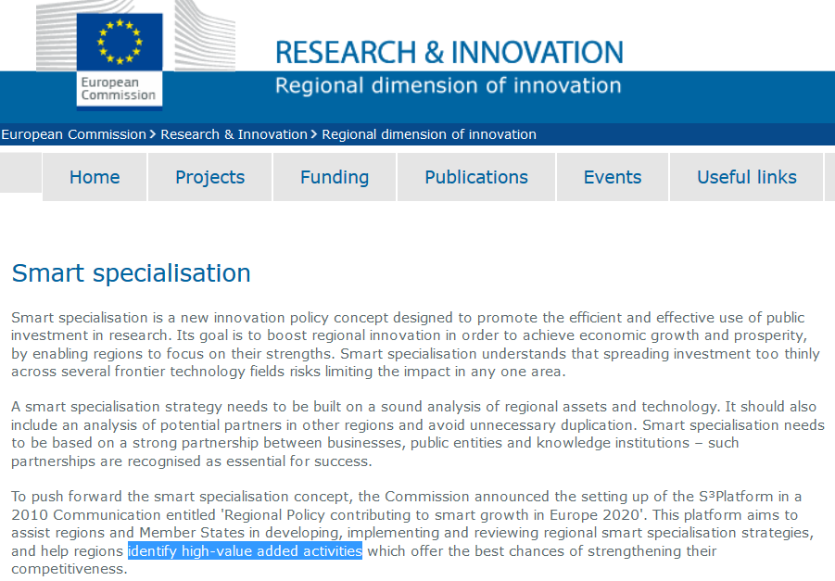
Identify opportunities

Slide 12
The smart specialization concept
The big societal challenge: how can regions develop new specializations?
Notes:
- Challenge for resilience exemlpe of oil

Slide 13
The smart specialization concept
The big societal challenge: how can regions develop new specializations?
It is not about making regions more specialized (not the diversity, specialization, RV debate)
Notes:
- Challenge for resilience exemlpe of oil

Slide 14
The smart specialization concept
The big societal challenge: how can regions develop new specializations?
It is not about making regions more specialized (not the diversity, specialization, RV debate)
The goal : smart specialization strategies aim at supporting the development of new specializations of regions
Notes:
- Challenge for resilience exemlpe of oil

Slide 15
The smart specialization concept
The big societal challenge: how can regions develop new specializations?
It is not about making regions more specialized (not the diversity, specialization, RV debate)
The goal : smart specialization strategies aim at supporting the development of new specializations of regions
“specialised diversification into related technologies” (Boschma, 2014)
Notes:
- Challenge for resilience exemlpe of oil

Slide 16
The smart specialization concept
The big societal challenge: how can regions develop new specializations?
It is not about making regions more specialized (not the diversity, specialization, RV debate)
The goal : smart specialization strategies aim at supporting the development of new specializations of regions
“specialised diversification into related technologies” (Boschma, 2014)
How: by building on their own strength (i.e. pre-existing knowledge bases & skills)
Notes:
- Challenge for resilience exemlpe of oil

Slide 17
Smart Specialization Strategy
Complexity
High Risks
High Benefits
Low Risks
High Benefits
High Risks
Low Benefits
Low Risks
Low Benefits
Relatedness
Balland, P.A., Boschma, R., Crespo, J. and Rigby, D. (2018) Smart Specialization policy in the EU: Relatedness, Knowledge Complexity and Regional Diversification, Regional Studies, forthcoming.

Slide 18
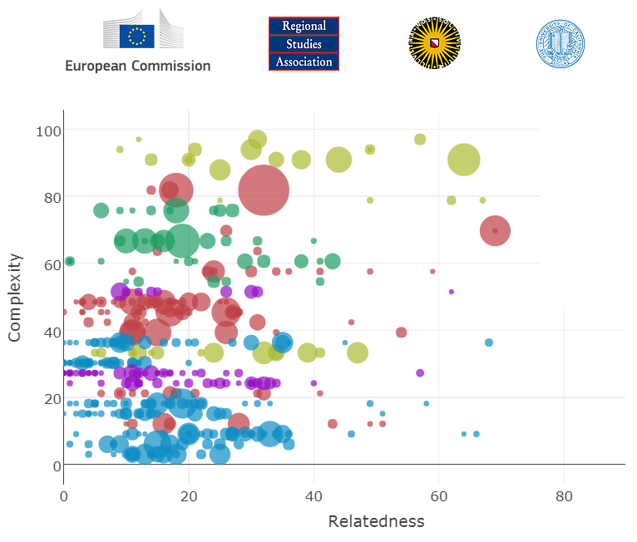
Smart Specialization Strategy
paballand.com/tools

Slide 19
3 sets of challenges
Map knowledge bases of regions
What are high valued-added/complex activities for a given region?
How do regions develop new specializations? (mechanisms)

Slide 20
First challenge
How to map knowledge bases of regions?

Slide 21
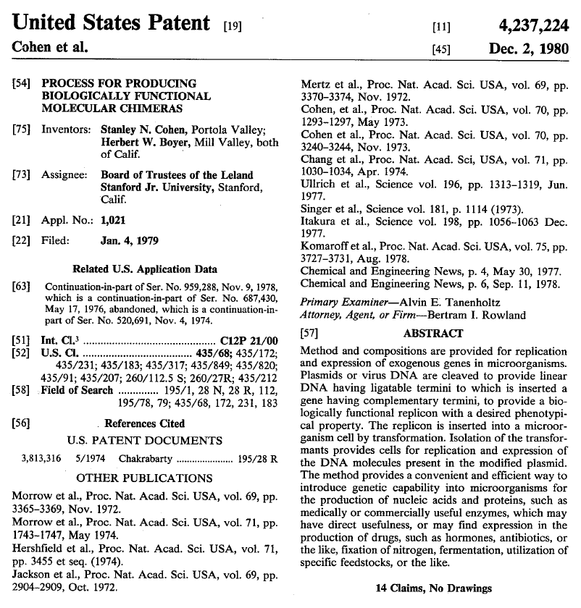
Patent data
Notes:
So we use patent as our primary source of information – like you guys use trade data
This patent is the famous Stanley cohen and herbert boyer patent, it is about gene-splicing and it launched the biotechnology industry – for nearly 17 years – all companies that wanted to use their discovery (Genentech or Merck and Amgen for instance, they had to pay licensing fees). We are talking about 200 millions revenue for this patent.

Slide 22
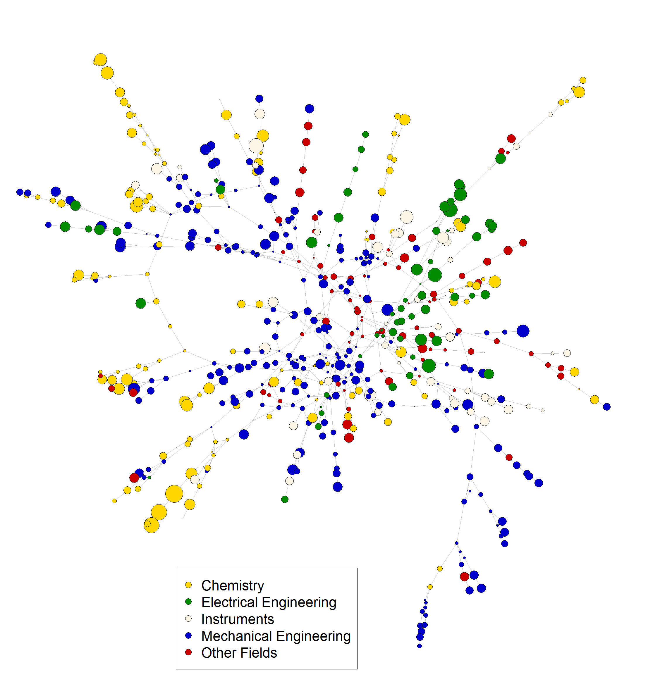
European Knowledge Space

Slide 23
The density of related technologies
City (MSA) | Tech. class (3 digits) | Density (%)
New-York | 428 | 10
New-York | 524 | 100
Los Angeles | 428 | 80
Los Angeles | 524 | 0
… | … | …
The Density Index measures the relatedness of a new technology to the pre-existing set of technologies produced in this particular city.

Slide 24
Branching opportunities

Slide 25
Second challenge
How to measure complexity of technologies?

Slide 26










Technological complexity
k knowledge
domains
n cities/regions
It is possible to formalize the data that connect cities/regions to the knowledge they produce as a n by k bipartite network (two different sets of nodes)
A link between a city i and a knowledge domain j means that i has a RTA in category j
See Hidalgo and Hausmann (2009) and Balland and Rigby (2017)

Slide 27
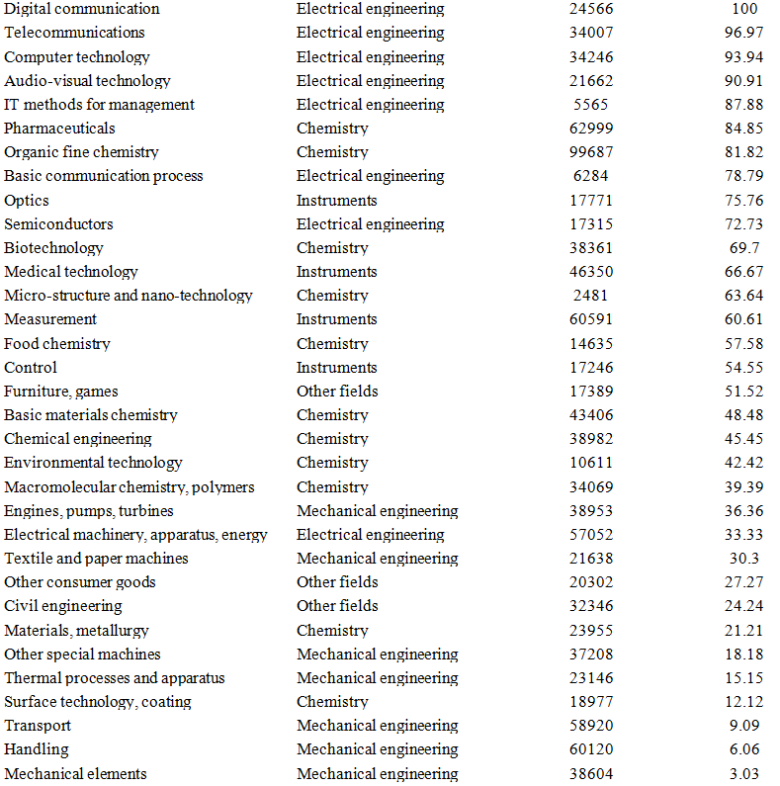

Slide 28
Third challenge
How do regions develop new specializations? (mechanisms)

Slide 29
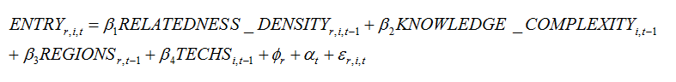

Slide 30


Hypotheses
H1: regions are more likely to develop new specializations in technological activities that are related to their knowledge bases
H2: regions are more likely to experience technological growth in technological activities that are related to their knowledge bases
H3: regions are less likely to develop new specializations in complex technological activities
H4: regions are more likely to experience technological growth in complex technological activities
H5: regions are more likely to develop new specializations in complex technological activities when related to their knowledge bases
H6: regions are more likely to experience technological growth in complex technological activities when related to their knowledge bases

Slide 32
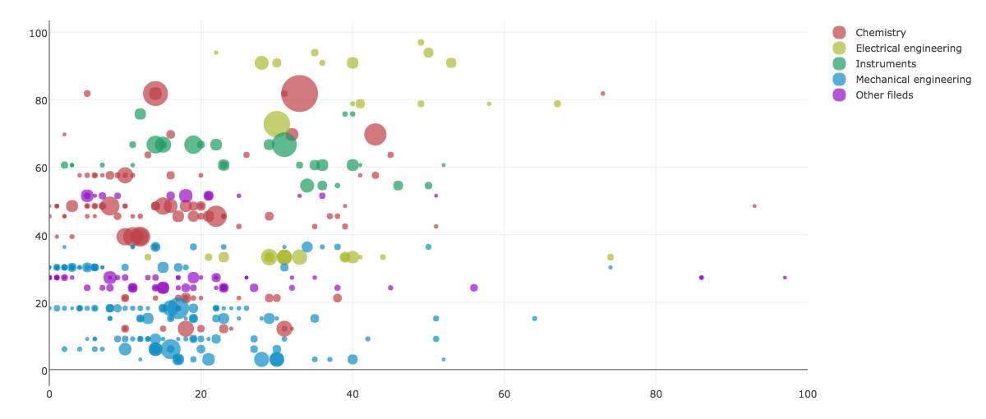
Île-de-France (France, FR10 )

Slide 33
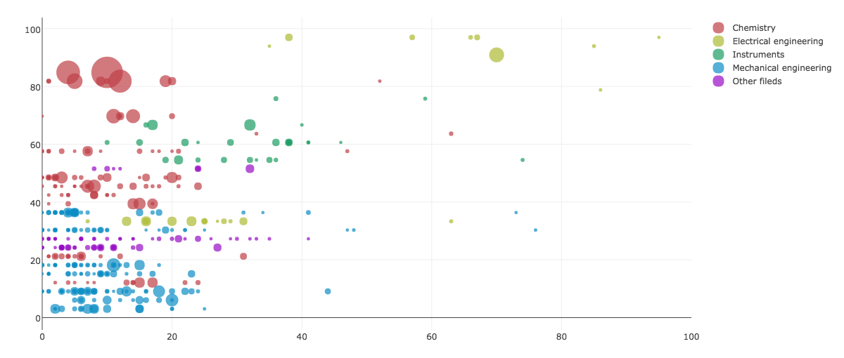
Noord-Brabant (Netherlands, NL41)

Slide 34
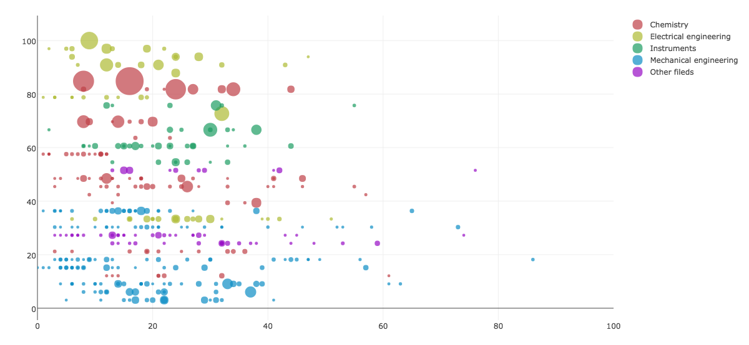
Lancashire (United Kingdom, UKD4)

Slide 35
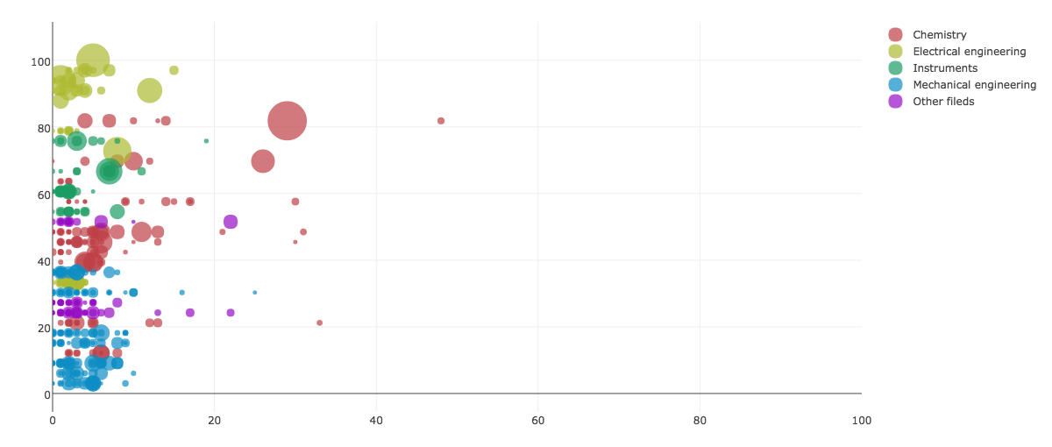
Extremadura (Spain, ES43)

Slide 36
Q&A

